Slide 1
SOCCER PLAYER ANALYSIS
Data Analysts: Alexandr Gorbulin, Rocky Owens, and Francis Shobo
February 8, 2023

Slide 2
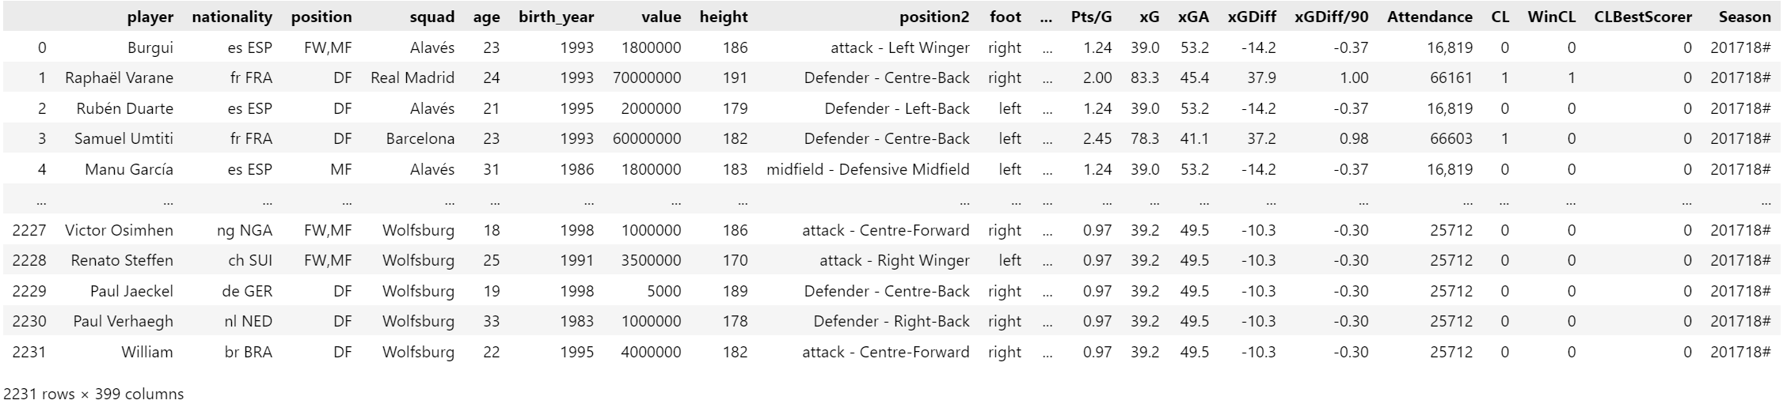
Scope & Purpose
Using a Kaggle.com merged data set from trasnfermarkt.de and fbref.com, soccer players from the top five
European leagues are analyzed using statistics to determine the relationship to player value.
The purpose of this soccer analysis is to reveal the statistics that make a player or soccer club more valuable than the others.

Slide 3
Questions
1. Which nationality has the most valuable players?
2. Which league has the most valuable players?
3. What is foot preference in relation to goals scored?
4. Which player plays the most minutes and receives the most red cards?
5. At what age is a soccer player at their highest value?
6. Which squad is the most valuable?
7. How does the league in which the player plays affect their value, goals scored, and minutes played?
8. How does the number of tackles and tackles won relate to the player's position?

Slide 4
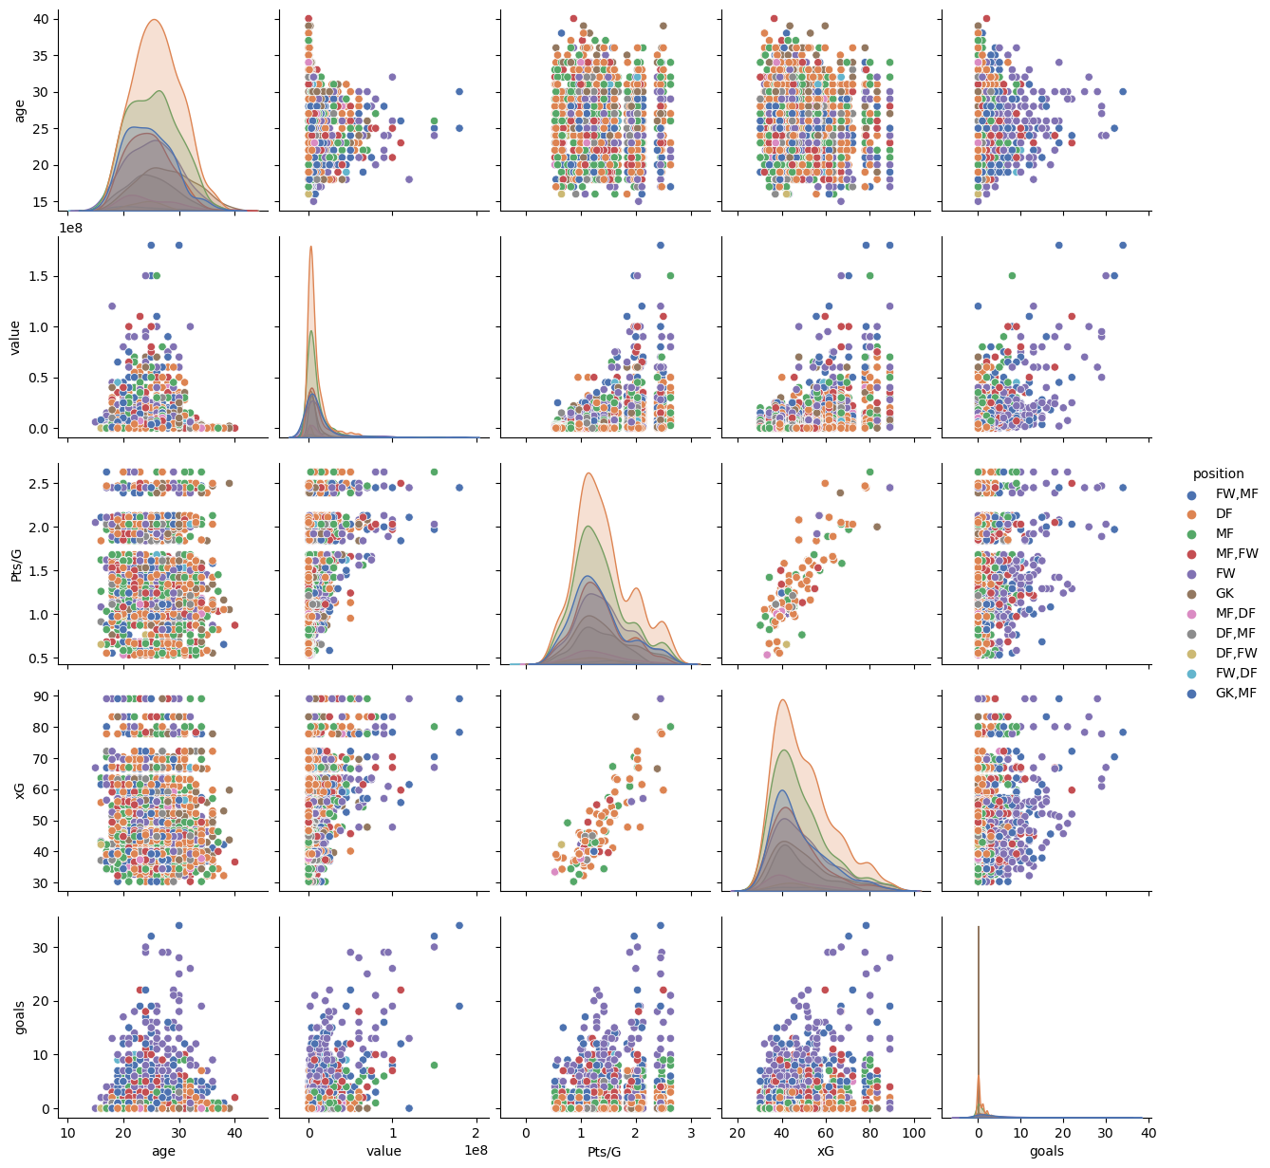
Seaborn Pair Plot – What data to use?
- Pair plot created to check for dependencies of the relationship between chosen variables.

Slide 5
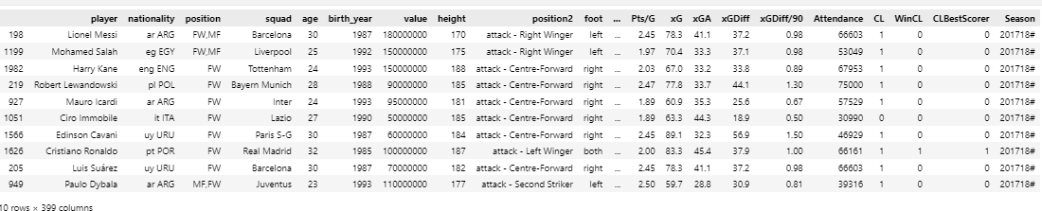
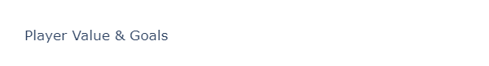
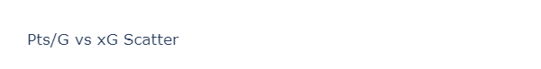
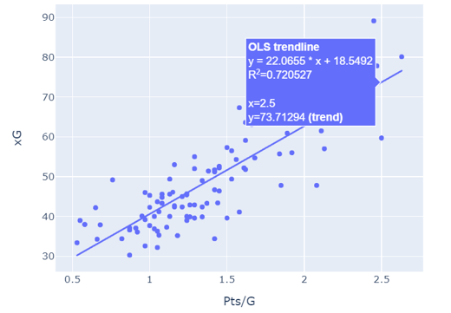
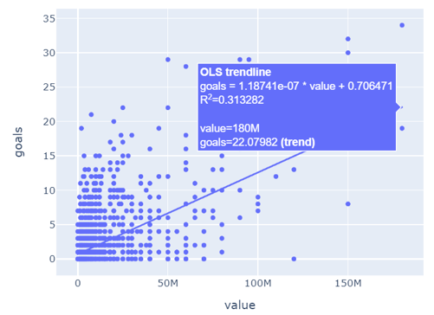
Player Goal Statistics

Slide 6
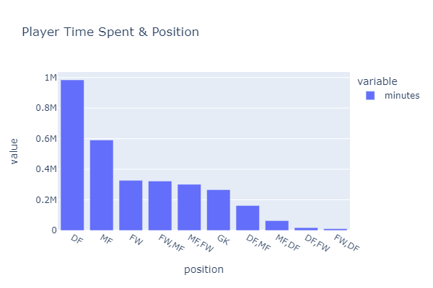
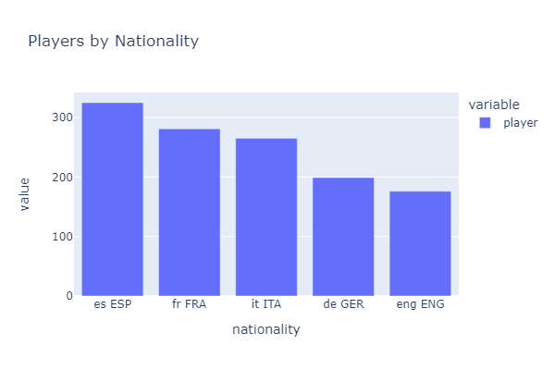
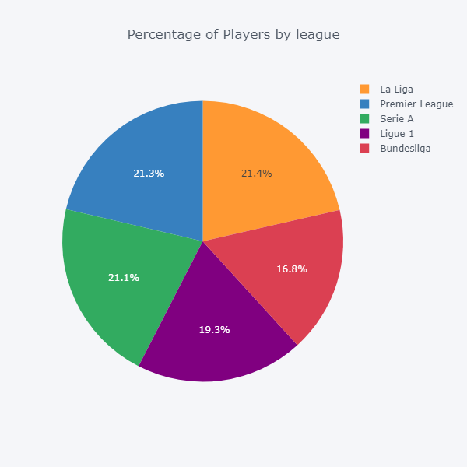
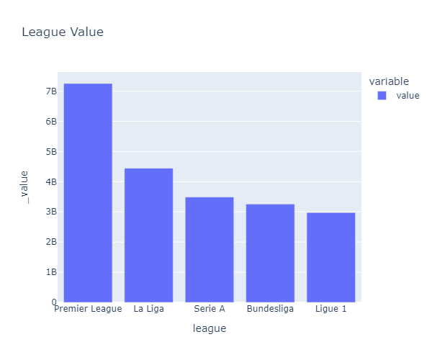
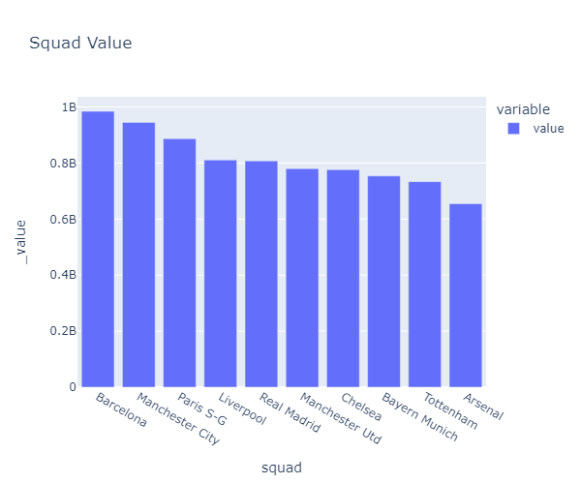
Main Players Statistics

Slide 7
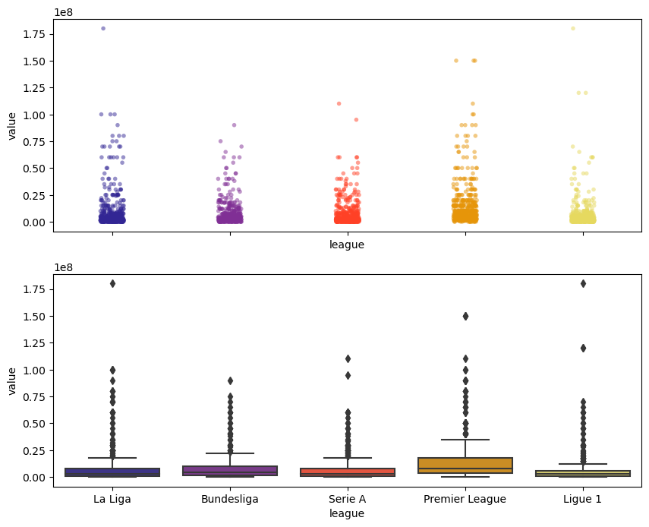
Scatter & Box Plot – Value vs. League
Replace with your own text

Slide 8
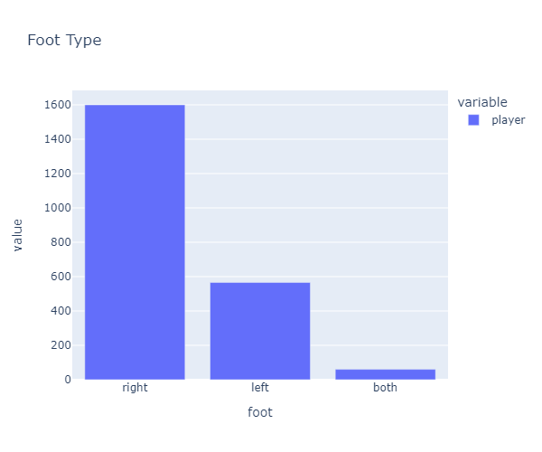
Foot Preference
Replace with your own text

Slide 9
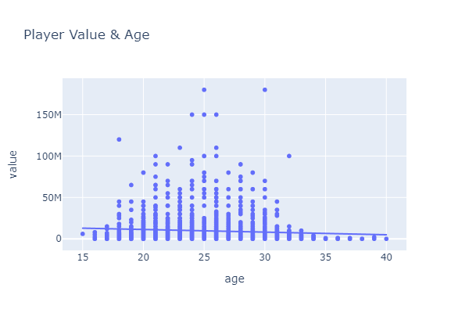
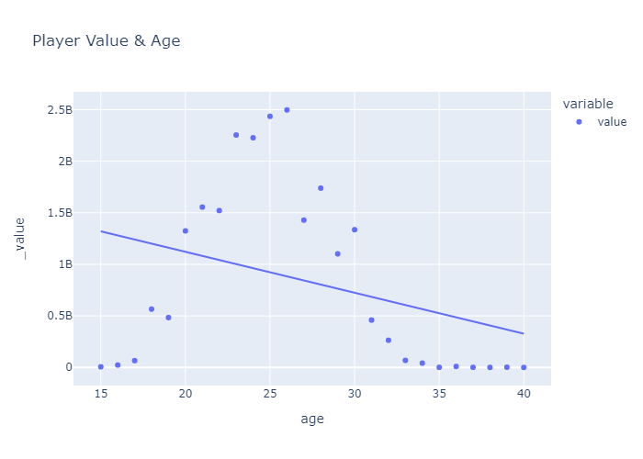
Player Value & Age
Replace with your own text

Slide 10
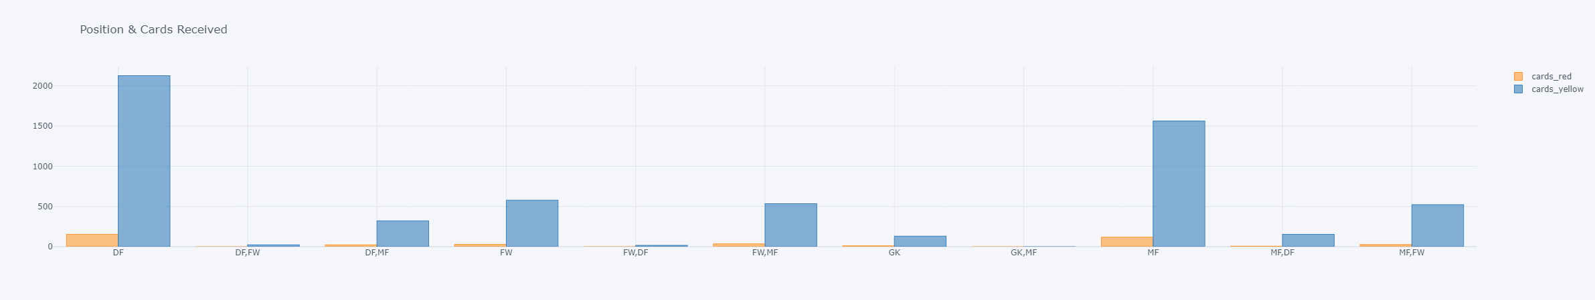
Player Position & Cards Received
Replace with your own text

Slide 11
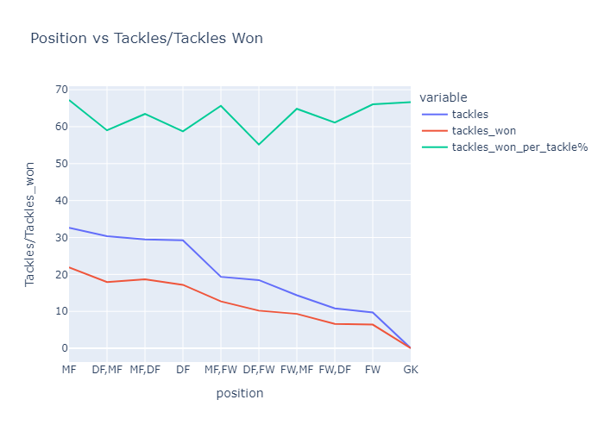
Player Position vs. Tackles/Tackles Won
Replace with your own text

Slide 12
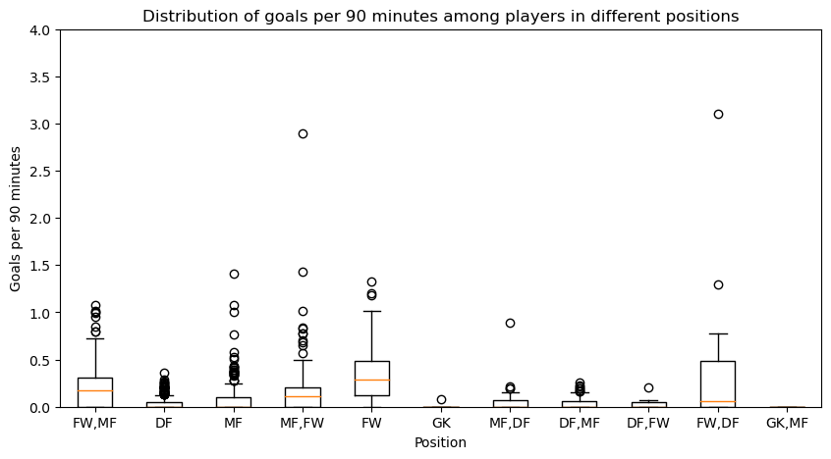
Goal distribution per Player Position
Replace with your own text

Slide 13
Analysis & Conclusions
Write up summaries, major findings, and implications.
Each question answered precisely with ample info
Findings strongly support #s & viz
Each question supported with statistical analysis (aggregation, correlation, comparison, summary stats, sentiment analysis, time series analysis, liner regression, etc.)

Slide 14
THANK YOU!

